Slide 1

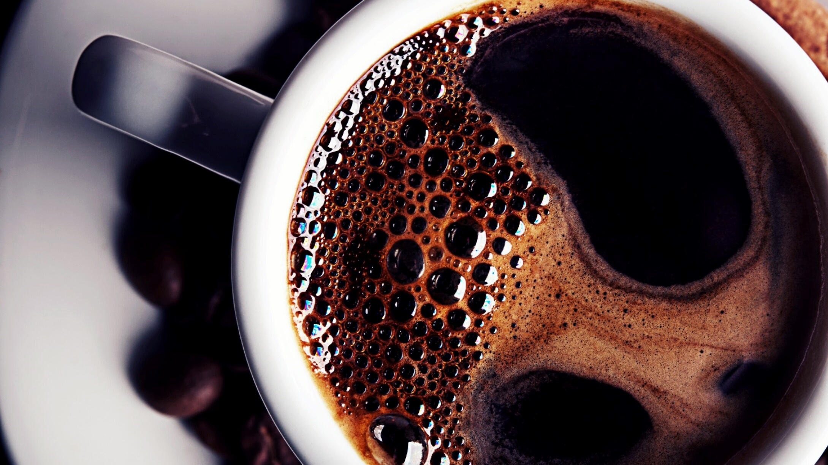
Fetching Data
HTML, MVC, JSON, and AJAX

Slide 2
HTML Requests
The two big ones
GET
POST
The “others”
HEAD
PUT
DELETE
CONNECT
OPTIONS

Slide 3
GET Requests
Any time you open up a webpage, it’s a GET request
You go to a URL and the server responds with data based on the URL you go to
Any additional information (arguments) are sent in the URL
Additional info
Reloadable
Can bookmark
Generally used for read-only operations

Slide 4
POST Requests
POST requests are for posting data to a server
It’s sent when a web form is submitted
Data can be sent as an attachment
Additional info
Cannot bookmark
Used for write operations

Slide 5
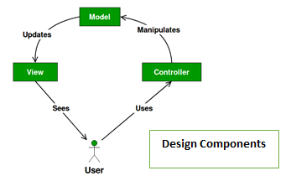
MVC
Model – View – Controller
MVC is a software design pattern (framework) commonly used to design web applications
It emphasizes a separation between the software’s business logic and the display

Slide 6
MVC – Why use it?
Benefits:
It’s stateful
Organizes large-size web applications
Nicely supports Asynchronous Method Invocation (AMI)
Easily extensible/modifiable
Easier Development for teams
And what are the biggest concerns:
There’s no “MVC” standard
The Jaded MVC tutorial

Slide 7
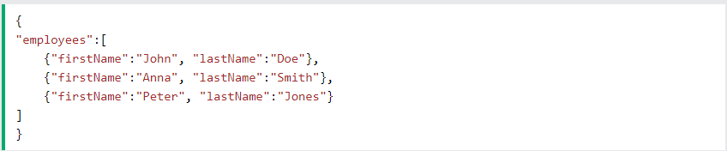
JSON
JavaScript Object Notation
JSON is an open standard for transferring data across the internet
Javascript’s objects are naturally JSON objects, meaning the code running in the browser will naturally translate into string data that can be sent to servers
In simple terms, JSON is a string-ified dictionary
Each piece of data has a key and a value
JSON Tutorial

Slide 8
AJAX
Asynchronous Javascript and XML
(don’t worry, we don’t need to use the XML part)
AJAX is the underlying method for building dynamically updating webpages
Otherwise, the only way a webpage will update is if we refresh/load a new page
AJAX is javascript that sends a new request within the current webpage to the server
You can then use Javascript to update sections of your page with the returned info
AJAX Tutorial

Slide 9
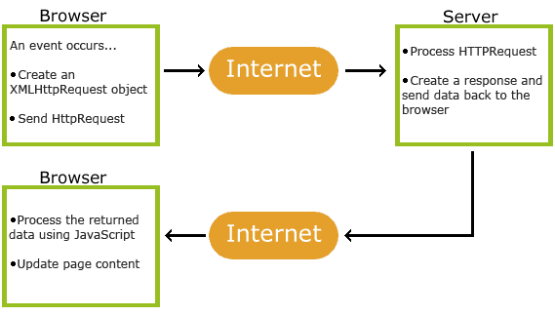
AJAX Example

